Slide 1


Emerging Technologies
Hackathon 2026
POWERED BY TCOE INDIA
Project Submission Template
Project / Solution Name
TeraMove : Self-Adapting Terahertz Nodes via Multidimensional Mobility for Indoor Scenarios
Team Name:
TeraMove

Slide 2
About the Team
Team Name
TeraMove
Institute / Organisation
Indian Institute of Technology, Bhilai
Technology Vertical
Communication
Team Members (1–5, with Role, Experience and Expertise)
Dr. Anand M. Baswade - Assistant Professor, Department of CSE
Mr. Arpit Bhomia - BTech Final Year Student, Department of CSE
Mr. Ashish Ranjan - BTech Final Year Student, Department of CSE
Mr. Arpit Kumar - BTech Final Year Student, Department of CSE

Slide 3
Problem Statement & Innovation
Problem Statement
Next-generation 6G/THz networks suffer severe signal degradation from dynamic physical blockages, such as shifting human crowds, which drastically reduce the effective transmission range. Traditional fixed access points cannot adapt to these rapid spatial changes, resulting in critical coverage dead zones and forcing expensive, inefficient over-provisioning that increases both capital costs and severe inter-node interference
Your Solution & Its Novelty
We introduce a swarm-optimized network of autonomous, physically movable THz transmitting nodes that actively respond to real-time environmental sensing. The core novelty is our multi-tier hierarchical optimization: it prioritizes instant electronic beam and azimuth adaptation, triggering vertical or full 3D spatial repositioning only as a strict last resort, which sustains maximum density-weighted coverage while drastically minimizing mechanical latency and operational wear.

Slide 4
Technical Feasibility & Implementation Readiness
Architecture & Design
Features a centralized controller coordinating a swarm of 3D-movable wireless nodes and real-time environmental sensors.
Employs an innovative 4-tier escalation workflow that strictly prioritizes rapid electronic beam tuning over physical movement.
Escalates to mechanical vertical or full horizontal repositioning only when target coverage thresholds cannot be met electronically.
Integrates linear sum assignment logic to ensure nodes take the shortest path, minimizing mechanical wear and latency.
Implementation Approach
Built a 3D simulation framework to accurately model room layouts, different wall materials, and how wireless signals travel through the environment.
Integrated dynamic grid mapping to track the real-time movement and density of human crowds, showing exactly where signal blockages occur.
Used a swarm intelligence algorithm to simultaneously calculate the absolute best signal coverage settings for the entire network of nodes.
Programmed a multi-step decision engine that strictly attempts to fix network dead zones electronically before forcing any physical hardware to move.
Applied the Hungarian algorithm to assign new coordinates, ensuring the physical nodes take the shortest possible route to save time and energy.
Validated the entire setup through rigorous testing, proving the software can compute and adapt to sudden environmental changes in just a fraction of a second.
Prototype Maturity
Successfully executed the core multi-tier optimization algorithm to validate the autonomous movement logic and coverage improvements.
Developed an interactive dashboard prototype to serve as a live demo, visually tracking the real-time node repositioning and network recovery.
Modeled and ran the simulation specifically using the architectural layout of the IIT Bhilai ED1 building to test against a realistic environment.
Validated the functional prototype within precise 32 m × 20 m × 3 m spatial dimensions to accurately account for physical heights and structural constraints.

Slide 5
Market Readiness & Commercialisation Plan
Target Market
Telecom & Infrastructure Providers: Network operators (e.g., AT&T, Jio) and infrastructure vendors (e.g., Ericsson, Nokia, Qualcomm) deploying next-gen 6G/THz networks.
Enterprise & Smart Facilities: Industry 4.0 automated manufacturing plants, smart building integrators, and dense venues like stadiums or airports.
Immersive Tech Venues: AR/VR gaming arenas and data centers requiring ultra-high-bandwidth, zero-drop connectivity.
Industry Alignment
CAPEX/OPEX Optimization: Directly addresses the telecom industry's mandate to reduce costs by eliminating the need for dense, over-provisioned fixed-node deployments.
Standards Compliance: Aligns with upcoming 3GPP and IEEE structural requirements for utilizing millimeter-wave and Terahertz spectrums efficiently.
Industry 4.0 Synergy: Fulfills the strict requirements for Ultra-Reliable Low-Latency Communication (URLLC) in environments disrupted by moving machinery and shift changes.
Go-to-Market Strategy
B2B Licensing Model: License the central controller's multi-tier optimization algorithm and software dashboard as a direct overlay to established telecom and enterprise networking vendors like Cisco.
Targeted Proof of Concepts (PoCs): Launch initial pilot programs in highly controlled, dynamic environments—such as automated warehouses or dense enterprise IT campuses—to prove ROI.
API Integration: Package the swarm intelligence logic as an API capable of integrating with existing building management systems (BMS) and environmental sensor grids.
Adoption Roadmap
Low Integration Friction: The 4-tier system prioritizes electronic beam tuning (Tiers 1 and 2), meaning it can optimize existing electronic hardware before requiring mechanical (Tiers 3 and 4) upgrades.
Demonstrable ROI & Efficiency: High adoption likelihood driven by minimized mechanical wear, reduced energy expenditure, and a drastic drop in required hardware units.
Seamless Scalability: The centralized swarm architecture scales effortlessly from a single smart room to a complex, multi-floor deployment without requiring total system replacements.

Slide 6
Economic Viability & Scalability
Economic Viability
Generates primary revenue by licensing our pending patent's multi-tier optimization algorithm directly to major telecom infrastructure equipment vendors.
Sustains financial growth through structured licensing agreements, minimizing our operational costs while maximizing software-driven profit margins.
Cost-Benefit Summary
Network operators save massive capital expenditure (CAPEX) by eliminating the need to buy and install dense, over-provisioned fixed nodes.
We achieve high profitability by providing the licensed software intelligence that makes their hardware investments radically more efficient.
Scalability Plan
The core multi-tier algorithm is entirely hardware-agnostic, enabling seamless technical scaling across sub-6 GHz, millimeter-wave (24–100 GHz), and Terahertz (100 GHz–10 THz) networks.
Geographical and market scaling is achieved instantly without physical manufacturing bottlenecks by deploying our software API directly into the ecosystems of global infrastructure vendors.
The centralized controller architecture scales fluidly from single-room smart factory deployments to massive, multi-zone indoor and outdoor enterprise networks.
Long-Term Business Success
Our primary revenue engine is built on high-margin, non-exclusive patent licensing agreements targeting major telecom equipment manufacturers (such as Ericsson, Nokia, and Qualcomm).
Long-term market dominance and operational success are legally secured through a continuous strategy of expanding our intellectual property portfolio around advanced, AI-driven spatial algorithms.

Slide 7
Security, Privacy & Compliance
Security Features
Utilizes encrypted control channels between the Central Controller and the THz nodes to prevent unauthorized physical actuation or rogue repositioning.
Implements a Zero-Trust architecture, ensuring the mechanical mobility platforms only accept commands from authenticated swarm algorithms.
Data Privacy
Privacy-by-Design: Environmental sensors (cameras/LiDAR/Wi-Fi probes) never record, store, or transmit Personally Identifiable Information (PII).
Edge-processing instantly converts raw sensor data into an anonymized mathematical density matrix (D(x, y, t)).
The optimization algorithm only registers human crowds as temporary Radio-Frequency (RF) attenuation obstacles (blockages), ensuring complete user anonymity.
Compliance & Standards
Designed to adhere to standard 3GPP and IEEE protocols for 5G-Advanced and upcoming 6G network architectures.
Meets physical safety and occupational hazard standards by enforcing minimum inter-node separation distances and safe transit pathways.
System Resilience
Autonomous Self-Healing: Powered by swarm intelligence; if one node fails or is heavily obstructed, the swarm automatically re-optimizes the remaining nodes to cover the dead zone.
Hierarchical Fallback: If mechanical movement components fail, the system falls back to Tier 1/Tier 2 electronic beamforming to maintain baseline coverage.

Slide 8
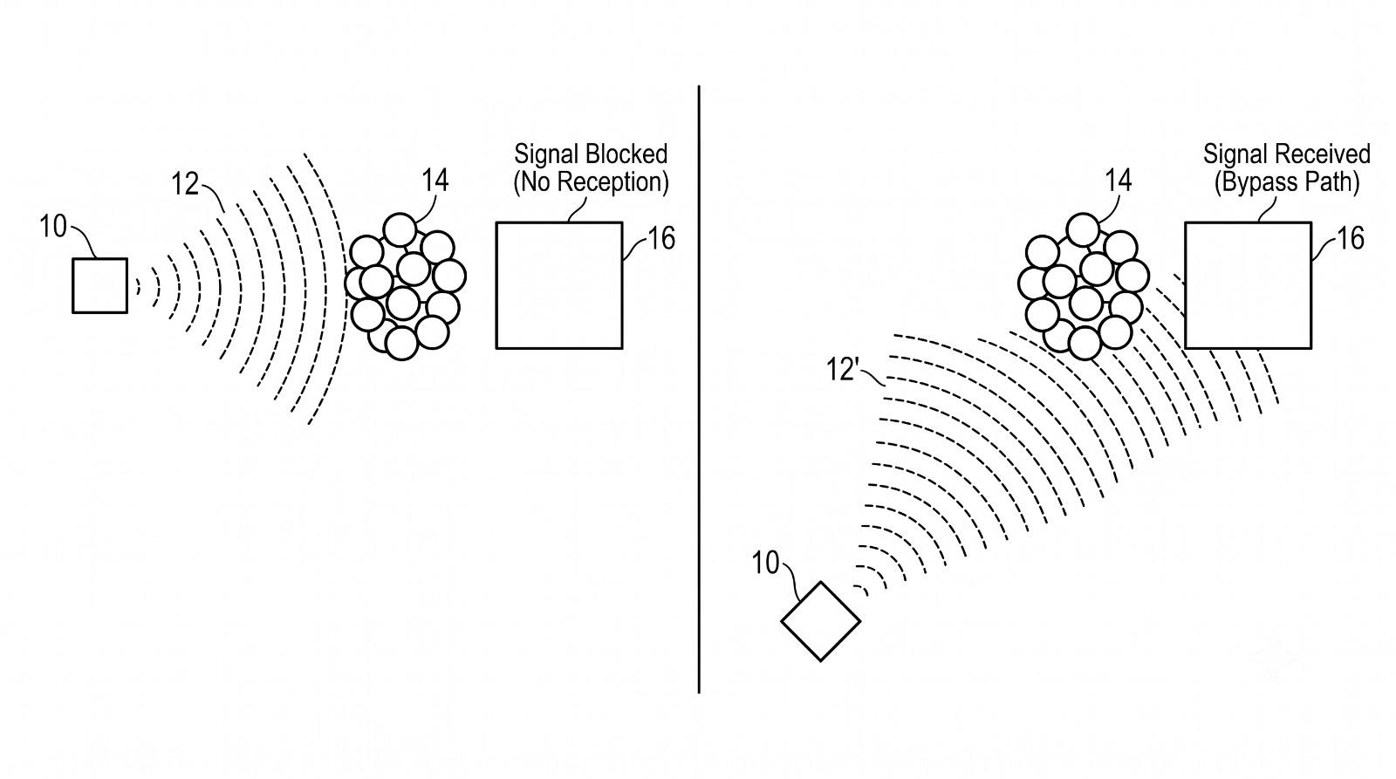
Prototype Demonstration & Functionality
Product / Solution Image
This diagram illustrates our core mechanism: when a dynamic obstacle blocks the signal (left), the autonomous node physically repositions itself to create a clear bypass path and restore the network connection (right).
Demo Details
Key Functionalities to be Demonstrated
Dynamic Blockage Mapping: Real-time tracking of the human density matrix that triggers the initial line-of-sight signal loss.
Swarm Optimization Engine: Live execution of the decision algorithm to calculate the new optimal 3D coordinates for the network.
Shortest-Path Assignment: Demonstrating the displacement logic that assigns nodes to their new coordinates while minimizing mechanical wear.

Slide 9
Additional Information & Closing
Additional Details
We have made a Interactive website where we can see this project in action. The website can be accessed from here :
References & Links
Patent Pending: "Autonomous Movement System for Coverage in High Frequency Bands" (Invention Disclosure Form drafted for IIT Bhilai).
Thank you for your submission.
TCOE India · Emerging Technologies Hackathon 2026

